Slide 1
CS 4331-201 Intelligent Planning and Diagnosis Project
Cameron Gibson

Slide 2
Initial Description: Schedule generator
You must assign ten employees to five flights
Each flight will require a specific number of employees
Each flight must have an employee who can speak the required language(s)
Each employee must have one flight off after attending a flight
Each plane must have the exact number of crew required
Given the attendants, languages spoken, the employees required, and the languages required, build a schedule that follows these rules

Slide 3
Information Given
Flight One:
2 Employees
English
Spanish
Flight Two:
2 Employees
English
German
Flight Three:
3 Employees
English
Spanish
German
Flight Four:
1 Employees
Spanish
Flight Five:
2 Employees
English
Spanish
German
Employees:
Richard
Halsey
Cameron
Alli
Billy
Jerry
Rob
Jacob
Gian
Rick

Slide 4
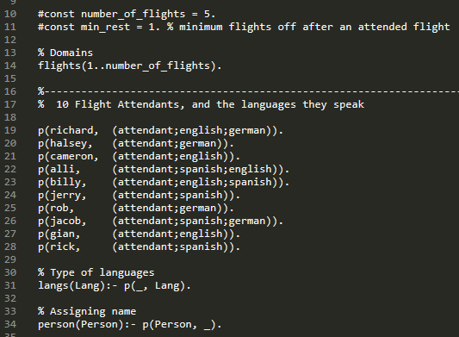

Slide 5

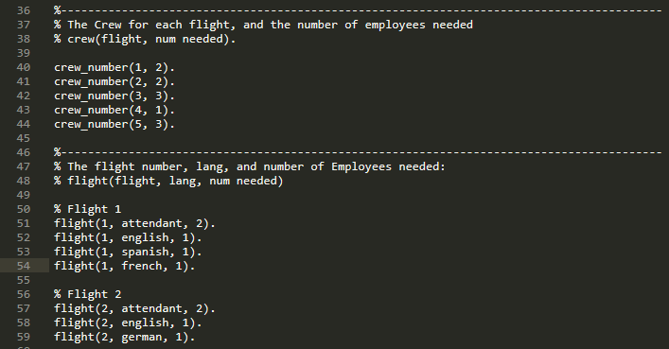

Slide 6

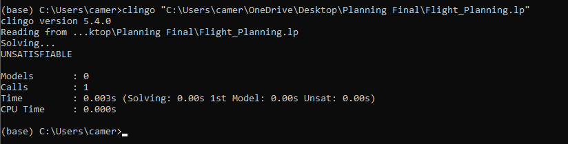
What happens if flight missing a requirement?
Here, we add French as a required language, but no employee can fulfill the requirement:
Output:

Slide 7
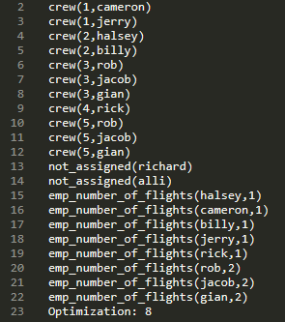
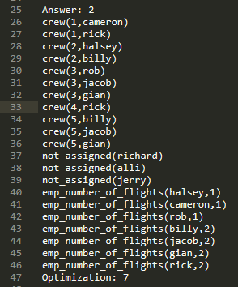
Solutions

Slide 8
